Slide 1
College of Information Conference Aug. 1 – 4, 2022
INFO 4306, Group 8 (SADIA MAHBUB)

Slide 2
Table of Contents
Project Scope
Work Breakdown Structure
Project Schedule
Project Budget
Project Checklist

Slide 3
Project Scope

Slide 4
Project Scope
Project Justification
Established in October 2008, the College of Information at the University of North Texas has provided a challenging and nurturing environment for students with nationally recognized and ranked programs at the undergraduate, graduate, and doctoral levels. In alignment with the College of Information’s commitment to quality education and community outreach, the goal of this project is to execute a four-day Career Conference for scholars on the University of North Texas campus.

Slide 5
The primary stakeholders for this project are the course instructors for INFO 4306/5306, who maintain final authorization of the project. Other clients include the stakeholders of the College of Information, and attendees of the Conference, including scholars and potential undergraduate or graduate students.
Who
This document provides the project management plan from contractors to provide a conference, to use across the workforce system. This conference will host 20 guest speakers and approximately 80 attendees in North Texas. This document provides the high-level deliverables for proposal for which a future WBS and finalized budget will be based upon; the anticipated budget of $50,000 will cover costs for staff, equipment, and operating costs.
What

Slide 6
...............................................................
When
Where
The conference is expected to take place August 1 – 4, 2022. Initiation, Planning, Execution, and Monitoring and Controlling phases are expected to range from final approval and authorization of this scope project through the end of the event. Closing phase is expected to finalize within two weeks after the event.
The conference will take place on the University of North Texas campus, Business Leadership Building. Planning and execution efforts preceding the event will take place online or in-person, at the discretion of the project team.

Slide 7
How
High-Level Deliverables
This section describes the high-level deliverables for which the team will be responsible for, as well as risks, constraints, assumptions, and acceptance criteria.
Note: Any activities not defined within the deliverables included within this document will initiate a Change Request and undergo evaluation by the change request board to determine effects on cost, schedule, scope, and client expectations.

Slide 8
Location and Parking Arrangements
What We Provide
Promotional Advertisement Video
Contraction of Catering, Audio/Video, and Set Up Crew
Contraction of Speakers, Sponsors, and Volunteers
Website Development
Health & Safety and Inclimate Weather Plans
Itinerary and Info Packets
Website Maintenance
Marketing
Gratuity Gifts and Swag-Bags
Coordination of Post-Conference Meeting

Slide 9
Work Breakdown Structure

Slide 10
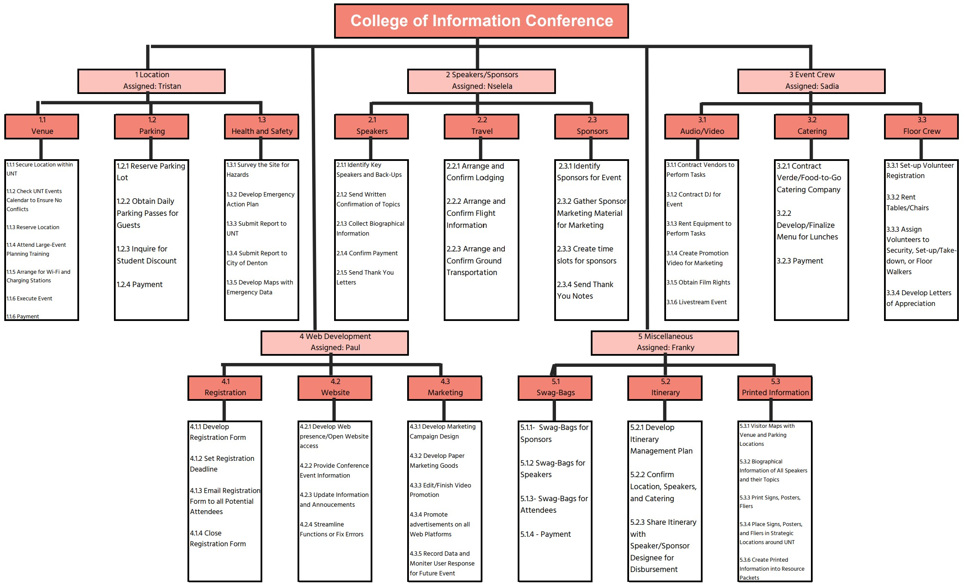

Slide 11
Project Schedule

Slide 12
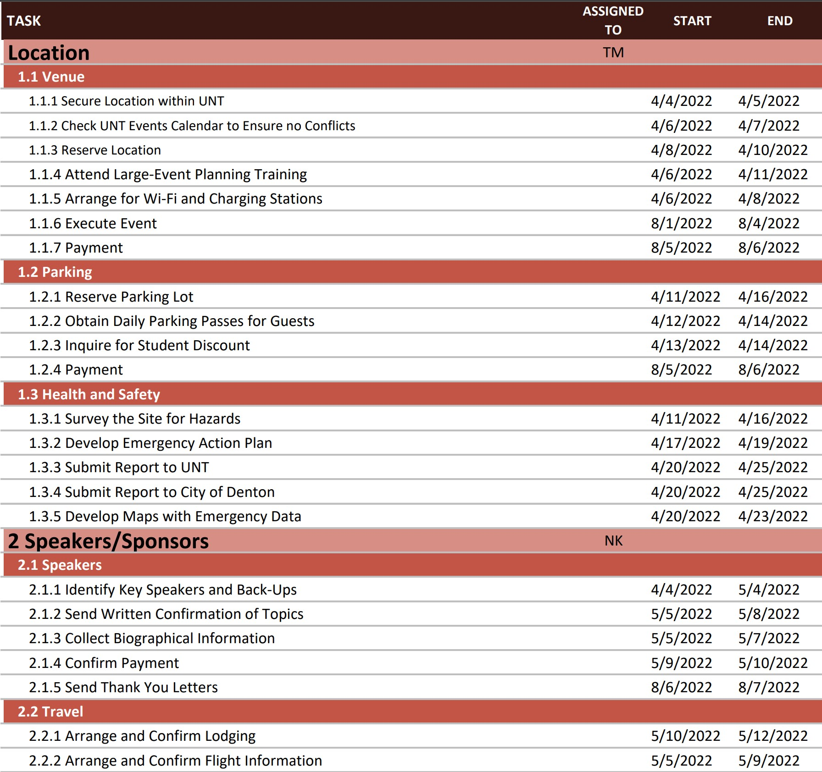

Slide 13
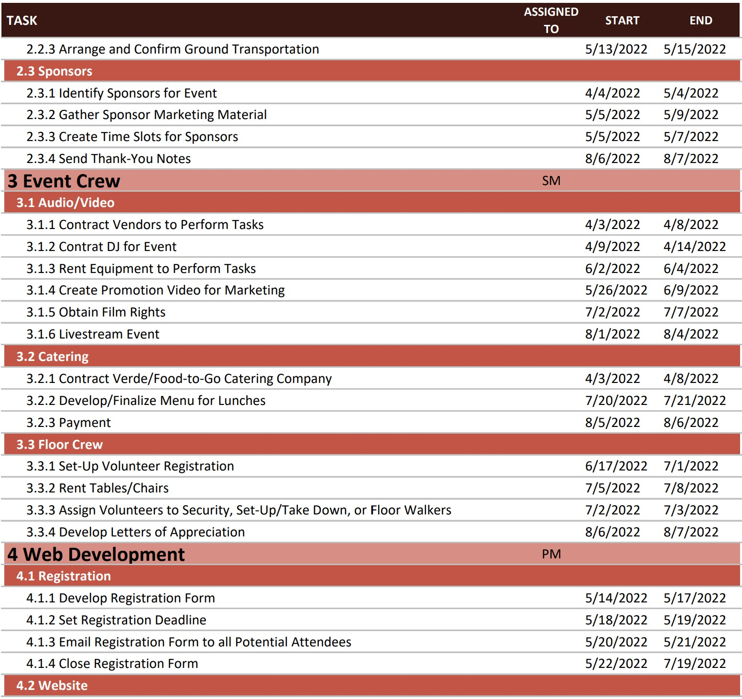

Slide 14
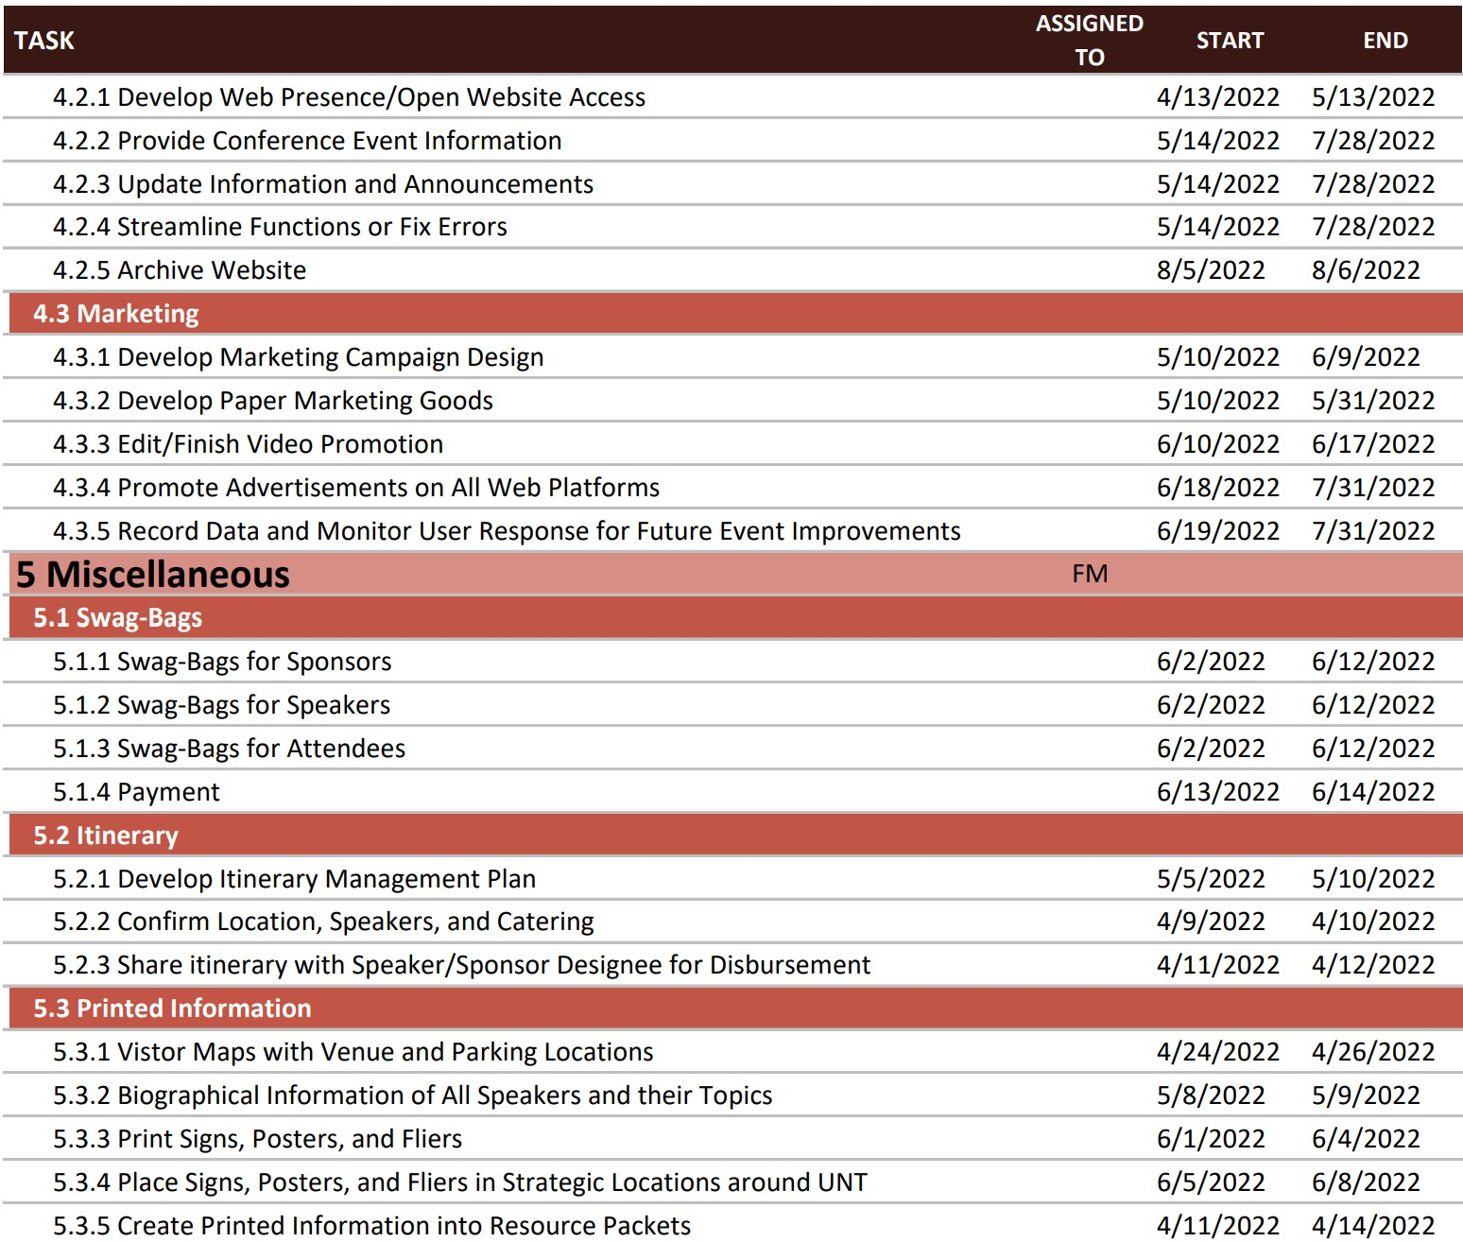

Slide 15
Project Budget

Slide 16
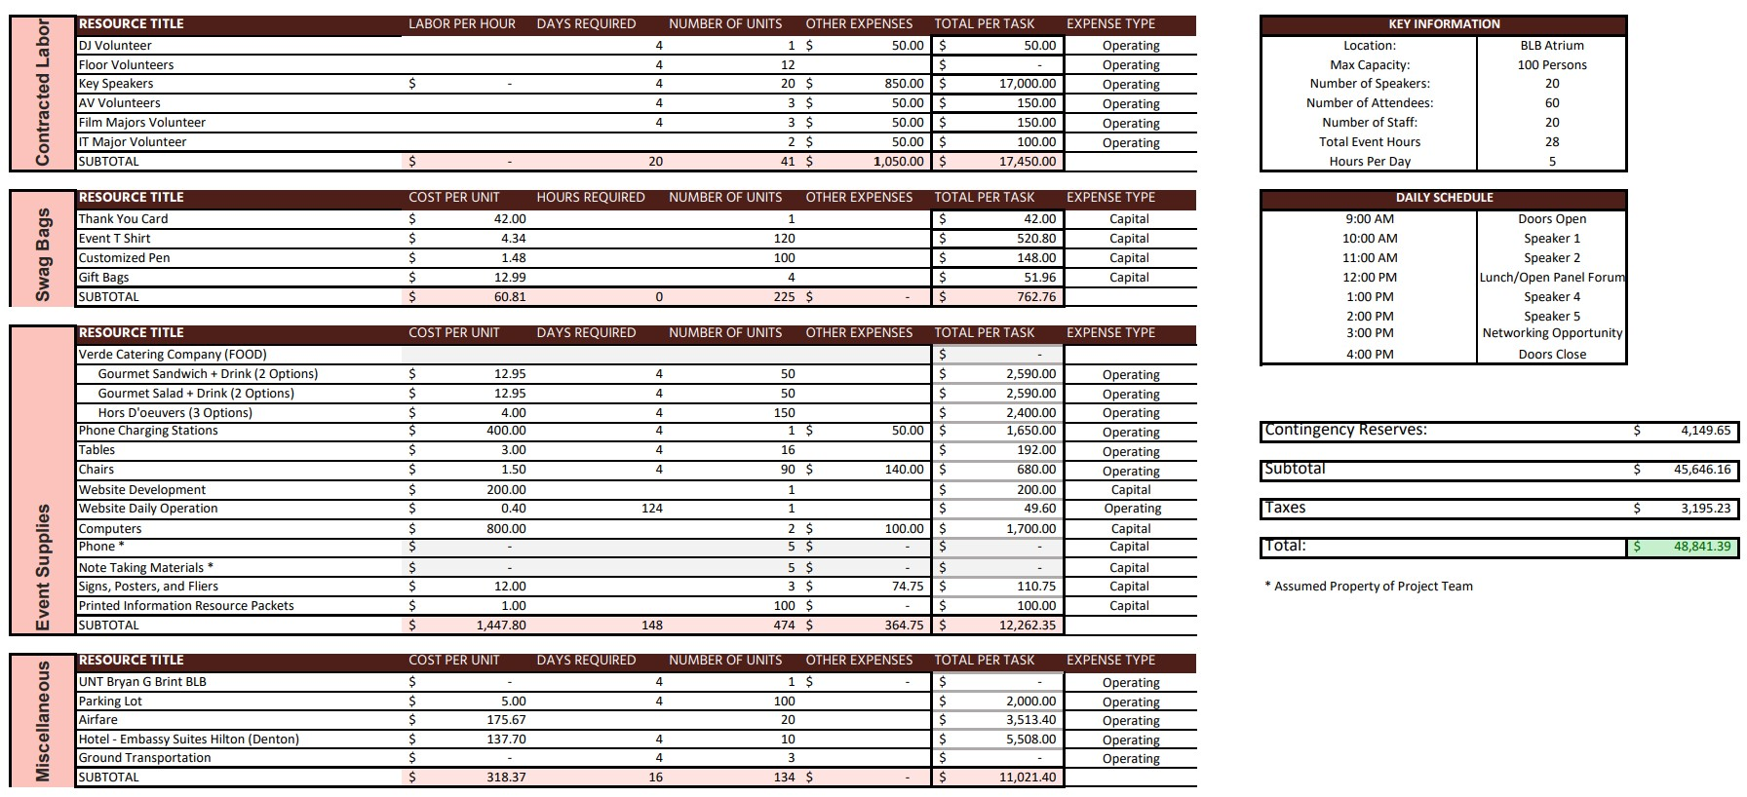

Slide 17
Project Checklist

Slide 18
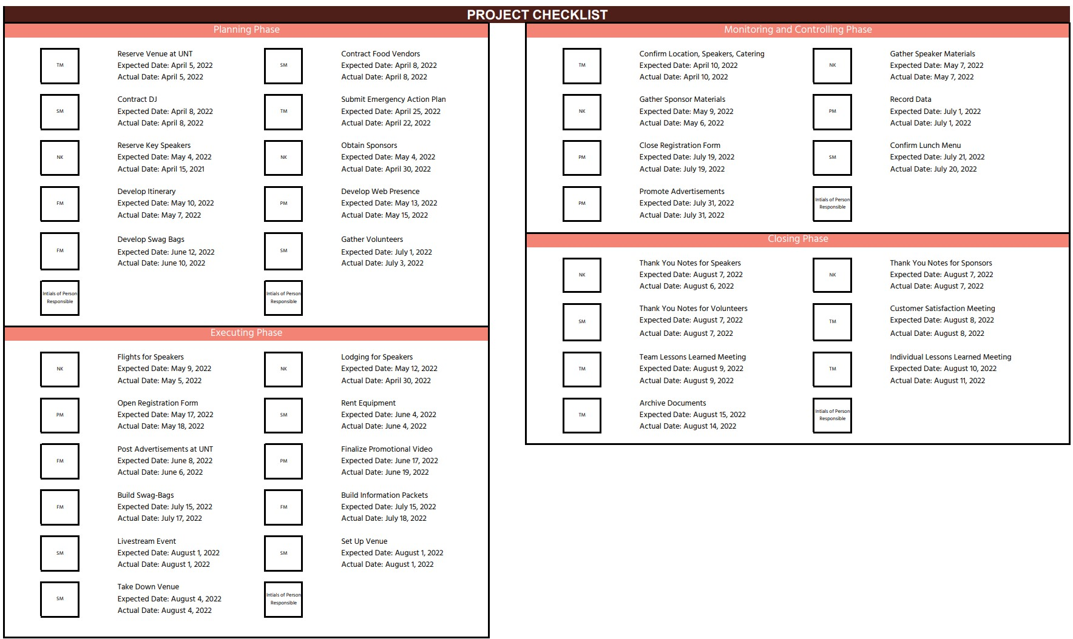

Slide 19
Thank you!

